Slide 1
The Year-long ISS Expedition, the Twins Study, and Preparations for Mars
2016 AIAA-Houston Awards Ceremony
Friday, June 10, 2016
Gilruth Center
John B. Charles, Ph.D.
Chief Scientist
NASA Human Research Program
Johnson Space Center, Houston, Texas USA
john.b.charles@nasa.gov
Notes:
Information on the topic of addressing and overcoming the biomedical challenges in sending astronauts to Mars or other destinations in space. Mars DRM was chosen to provide a challenging set of scenarios to address.

Slide 2
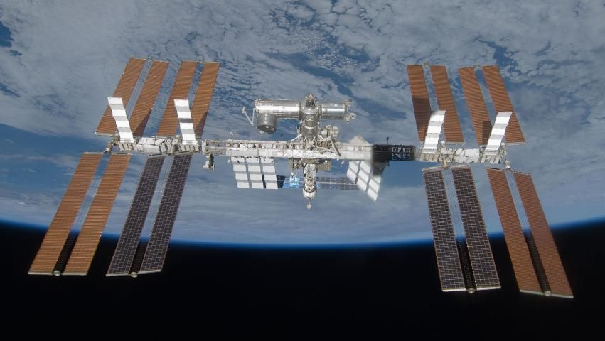
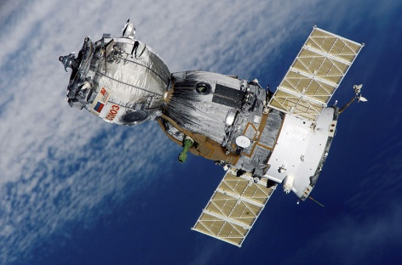
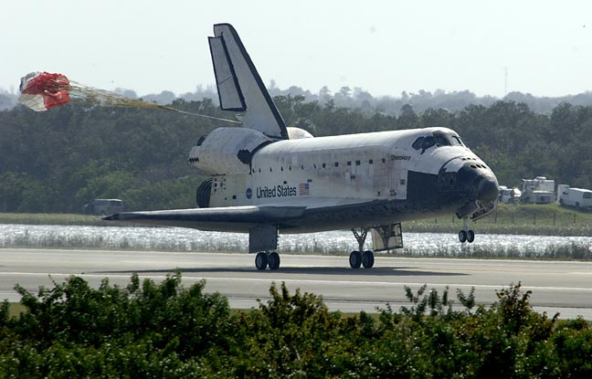
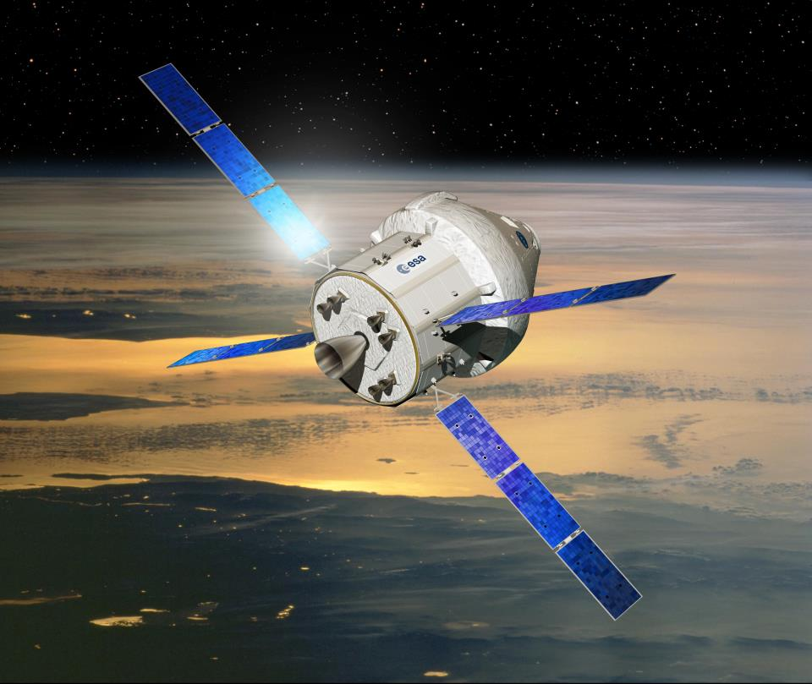
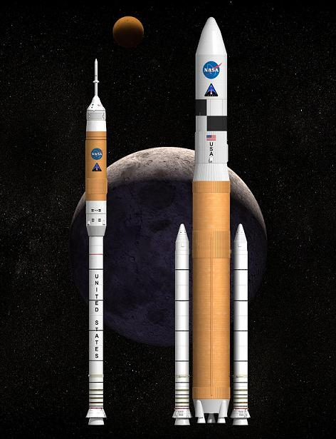
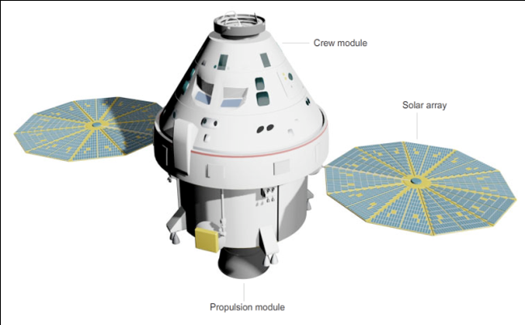
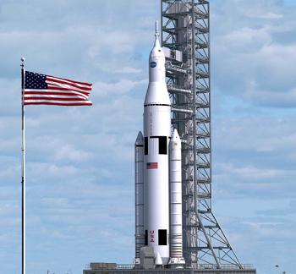
Recapping recent events in human spaceflight…
Shuttle ended, ISS through 2024, Soyuz continues,
Constellation cancelled, Orion continues
, SLS initiated

Slide 3
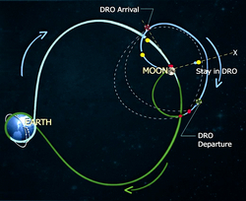
Orion & SLS
EFT-1 (2014)
EM-1 (nlt Nov. 2018) EM-2 (net 2023)

Slide 4
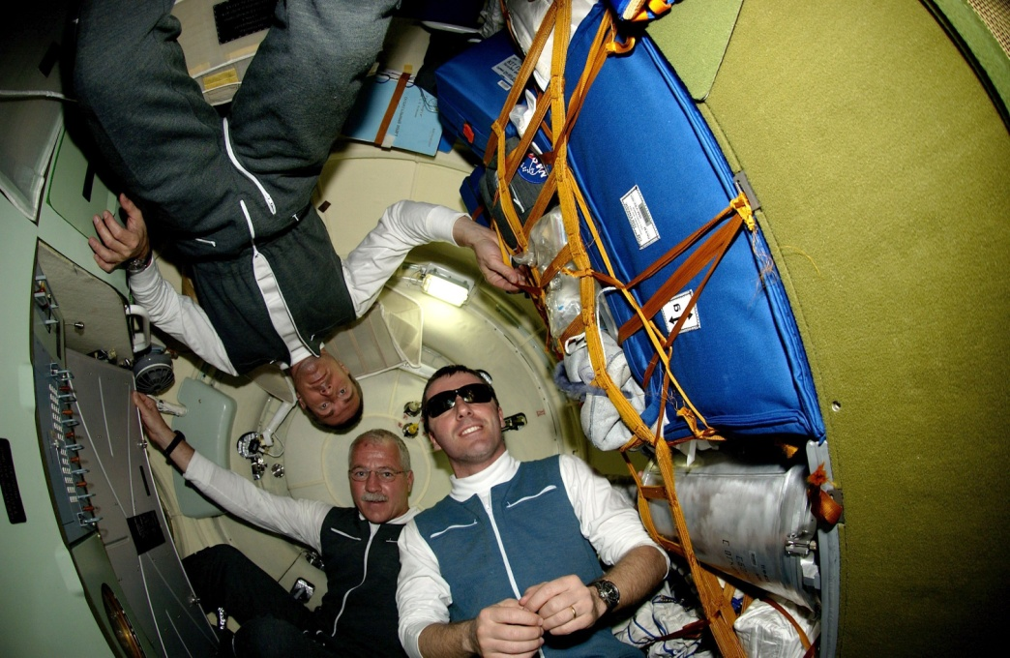
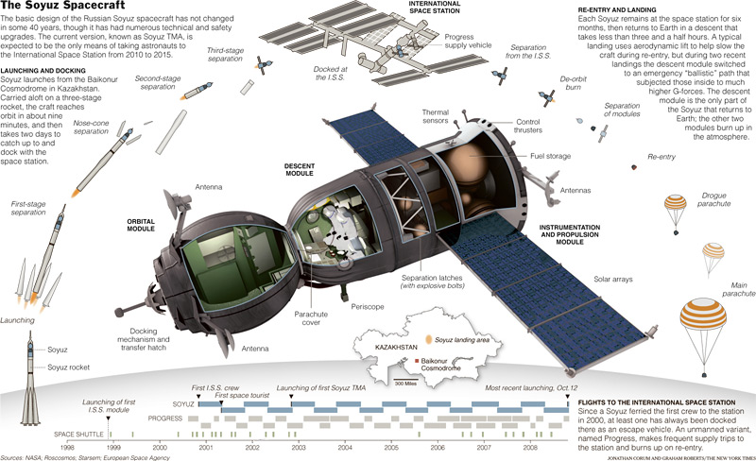
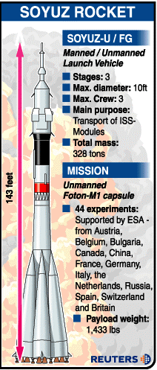
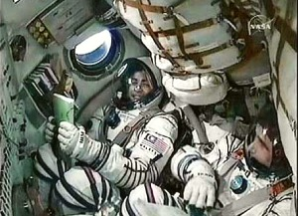
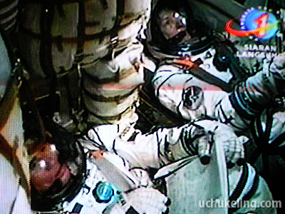
How do astronauts get to ISS without Shuttle?
Soyuz (RSC Energiya)
First test flight : 1966
129 have launched manned since 1967
45 have gone to ISS as of March 2016
Lifetime in orbit
180 days nominally
+ 30 days reserve
3
Notes:
3

Slide 5
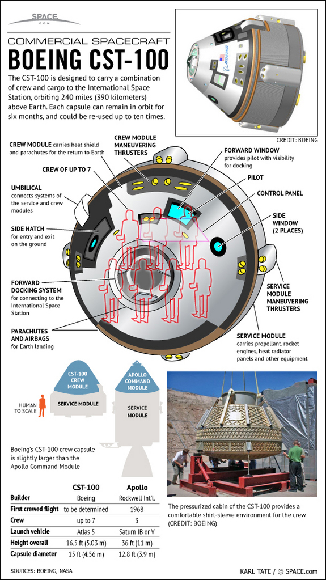
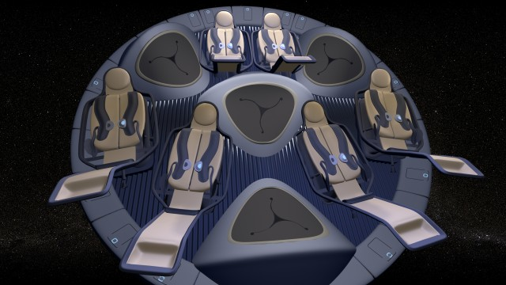
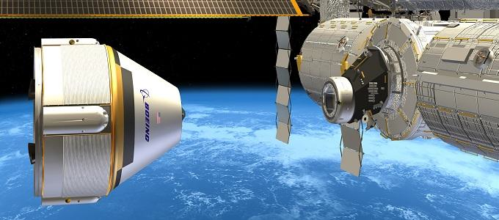
How else can astronauts get to ISS without Shuttle?

Slide 6
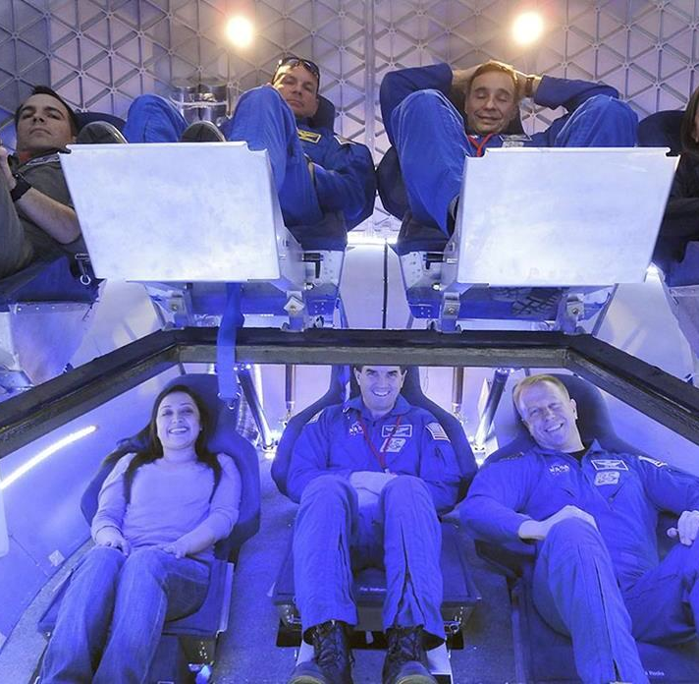
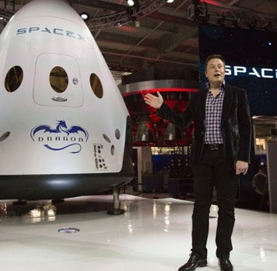
How else can astronauts get to ISS without Shuttle?
Dragon-Falcon 9 (SpaceX )
First test flight : 2010
First ISS cargo flight : 2012
First piloted test flight : 2017?

Slide 7
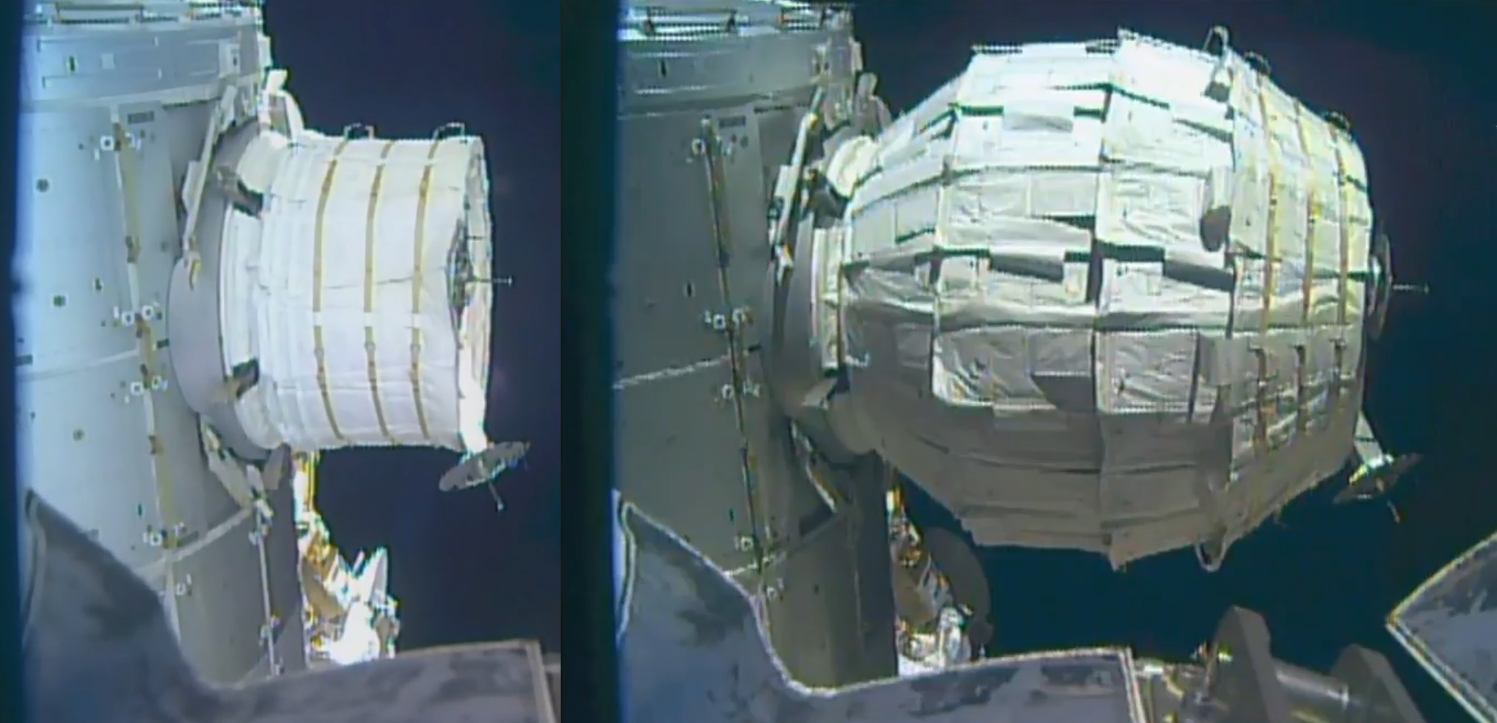
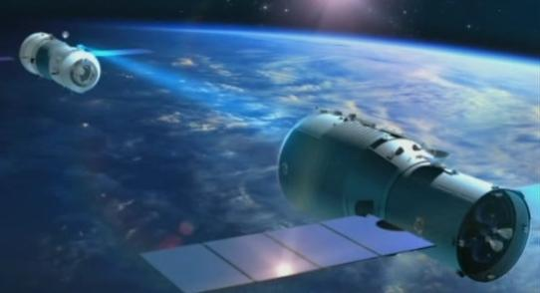
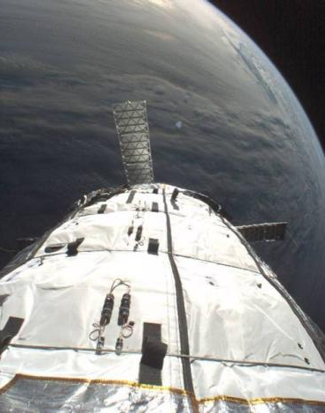
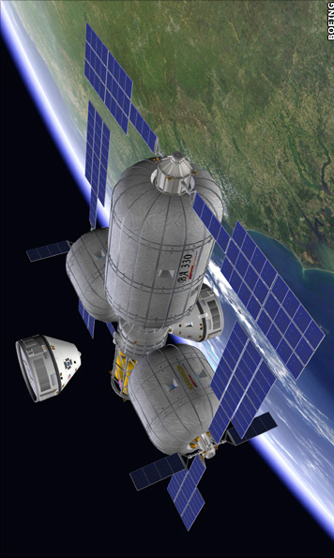
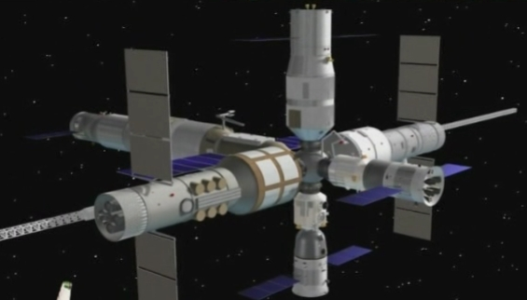
If not ISS (after 2024), then where else is there to go?
ow
Bigelow
BEAM (2016)
Genesis1 (2006)
Genesis 2 (2007)
Tiangong & Shenzhou (China)
2011-2017
Chinese International Space Station
2024…?
BA-330 (USA)
Was 2014, now…?
Notes:
6

Slide 8
Cis-Lunar Habitat Concepts

Slide 9
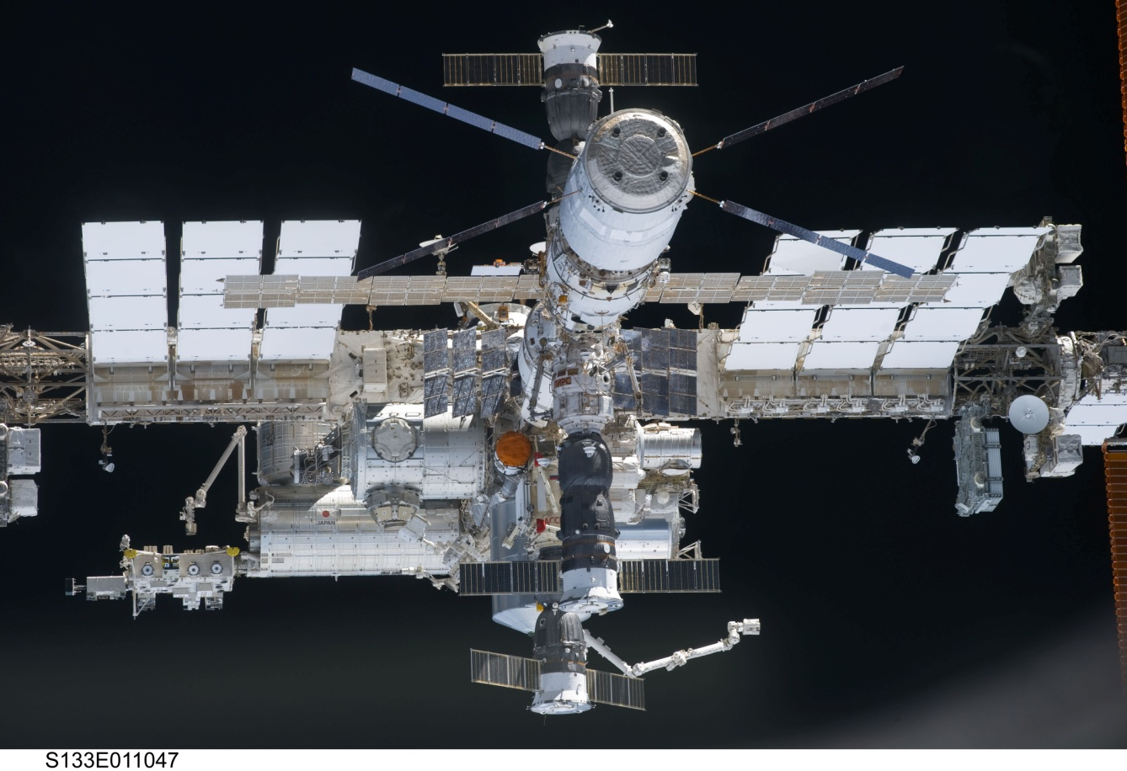
International Space Station

Slide 10
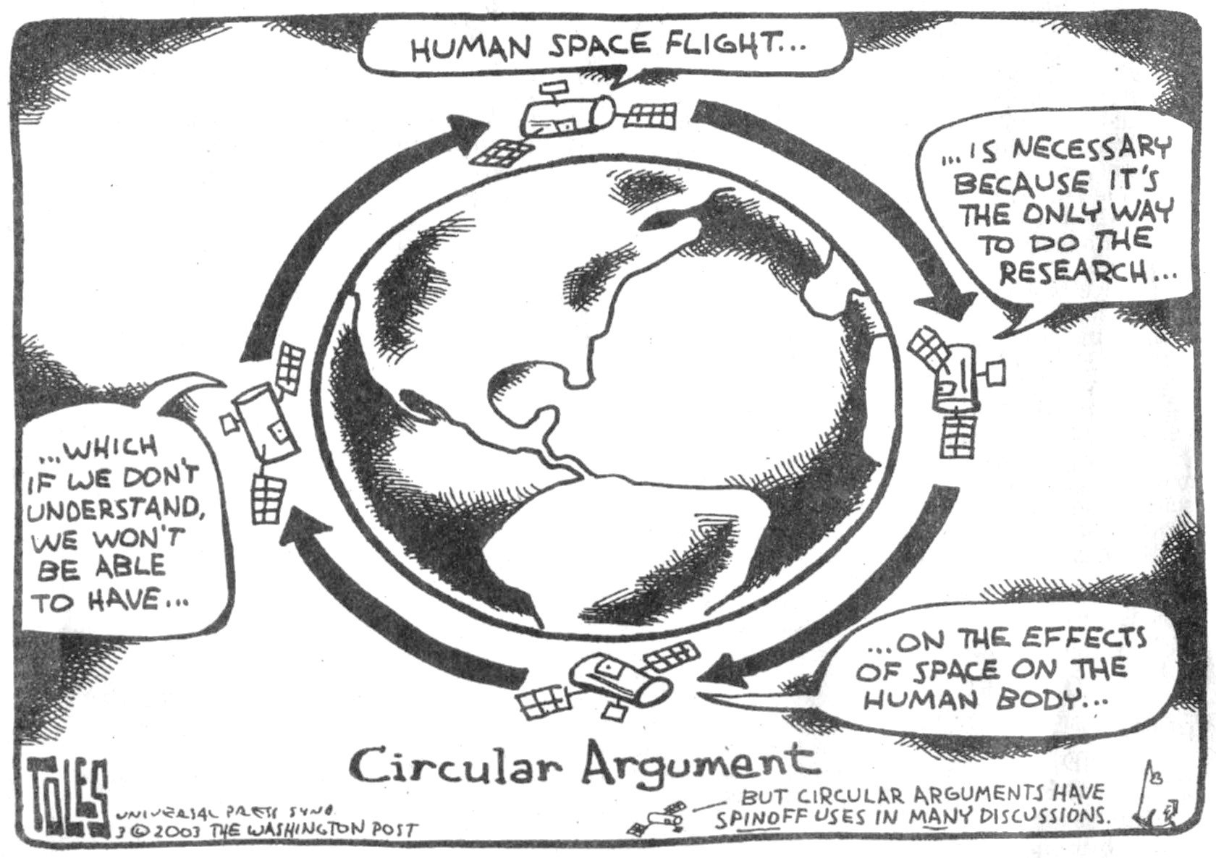
“Burning holes in the sky?” “Going around in circles?”

Slide 11
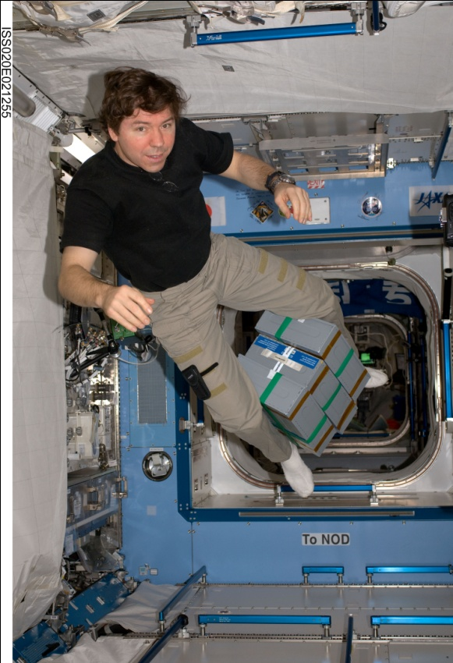
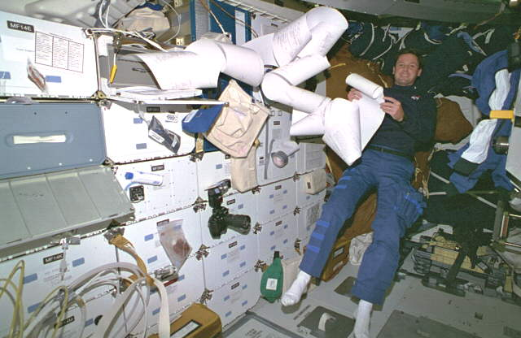
Human Responses to Weightlessness
Changes in Body Functions in 0g
Change in Hydrostatic Pressures in 0g

Slide 12
Spaceflight Medical Conditions/Events
Abdominal Injury
Abdominal Wall Hernia
Abnormal Uterine Bleeding
Acute Arthritis
Acute Cholecystitis/Biliary Colic
Acute Compartment Syndrome
Acute Diverticulitis
Acute Glaucoma
Acute Pancreatitis
Acute Prostatitis
Acute Radiation Syndrome
Acute Sinusitis
Aerobic Capacity Loss
Allergic Reaction (mild to moderate)
Altitude Sickness/Hypoxia
Angina/ Myocardial Infarction
Anaphylaxis
Ankle Sprain/Strain
Anxiety
Appendicitis
Atrial Fibrillation/ Flutter
Back Injury
Back Pain (SAS)
Barotrauma (sinus block)
Behavioral Emergency
Burns secondary to Fire
Cardiogenic Shock secondary to Infarction
Chest Injury
Choking/Obstructed Airway
CO₂ Headache/ICP/Cognitive
Constipation (SAS)
Decompression Sickness Secondary to EVA
Dental: Exposed Pulp, Caries, abscess, tooth filling/crown loss
Depression
Diarrhea
Dust Exposure (Celestial)
Elbow Dislocation
Elbow Sprain/Strain
Electric Shock Injury
Eye Abrasion (foreign body)
Eye Chemical Burn
Eye Corneal Ulcer
Eye Infection
Eye Penetration (foreign body)
Finger Dislocation
Fingernail Delamination (EVA)
Gastroenteritis
Head Injury
Headache (Late, SAS)
Hearing Loss
Hemorrhoids
Herpes Zoster
Hip Sprain/Strain
Hip/Proximal Femur Fracture
Hypertension
Immune System Dysfunction/Illness
Indigestion
Influenza
Insomnia
Knee Sprain/Strain
Landing Loads/Injuries
Lower Extremity Stress Fracture
Lumbar Spine Fracture
Malnutrition
Microbial-Host Interaction
Medication Overdose / Reaction
Mouth Ulcer
Muscle Atrophy
Nasal Congestion (SAS)
Nephrolithiasis(renal stone)
Neurogenic Shock
Nose bleed (SAS)
Orthostatic Intolerance
Otitis Media/Externa
Paresthesia
Pharyngitis
Respiratory Infection
Retinal Detachment
Seizures
Sepsis
Shoulder Dislocation
Shoulder Sprain/Strain - EVA
Skin Abrasion, laceration
Skin Infection
Skin Rash
Small Bowel Obstruction
Smoke Inhalation
Space Motion Sickness/Neurovestibular
Stroke (CVA)
Sunlight Exposure/Sunburn
Sudden Cardiac Arrest
Toxic Exposure: Ammonia+
Traumatic Hypovolemic Shock
Urinary Incontinence (SAS)
Urinary Retention (SAS)
Urinary Tract Infection
Vaginal Yeast Infection
VIIIP – Visual Impairment/ Increased Intracranial Pressure
Wrist Fracture
Wrist Sprain/Strain
Conditions in Blue have a dedicated Human Risk based on occurrence/need to understand/requires additional mitigation.

Slide 13
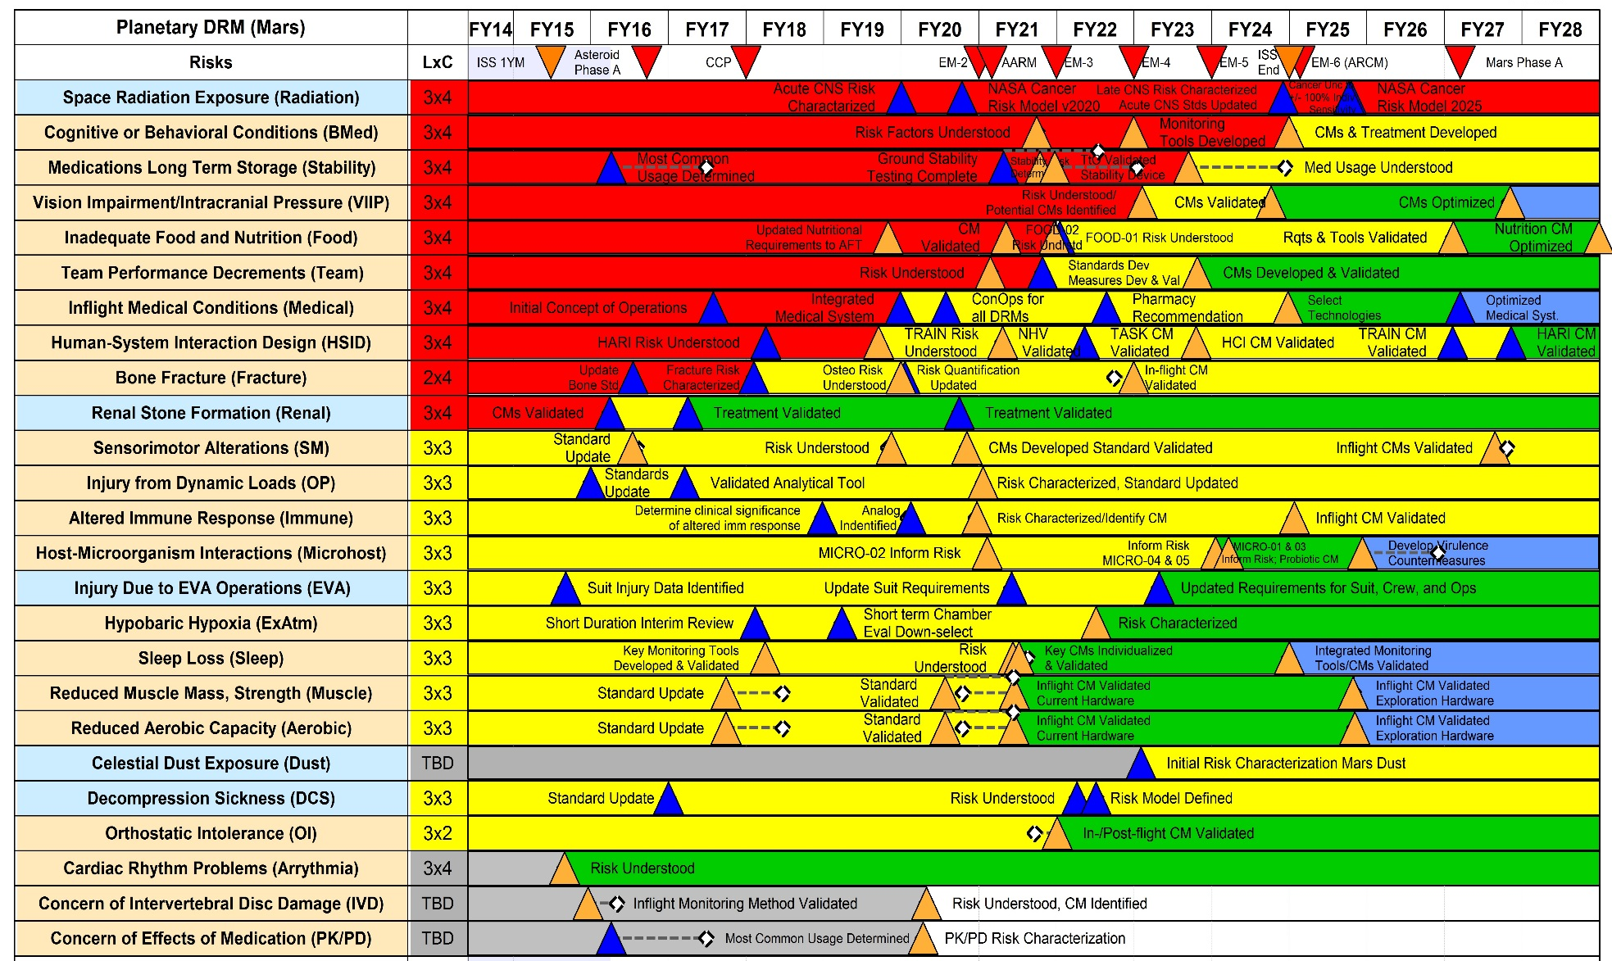
HRP Integrated Path to Risk Reduction
Accepted
Risks
Concerns
ISS Required
Milestones Requires ISS
ISS Mission Milestone
Anticipated Milestone Shift
End ISS
ISS Not Required
Ground-based Milestones
Mission Milestone
Hi LxC
Mid LxC
Low LxC
Optimized
Insufficient Data

Slide 14
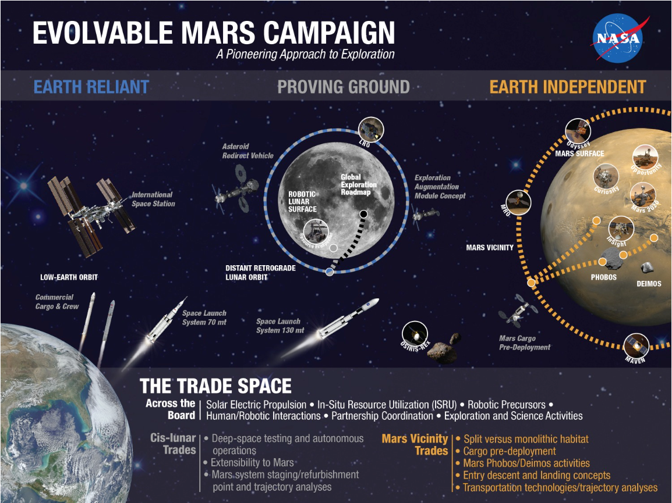
Planned Exploration Activities

Slide 15
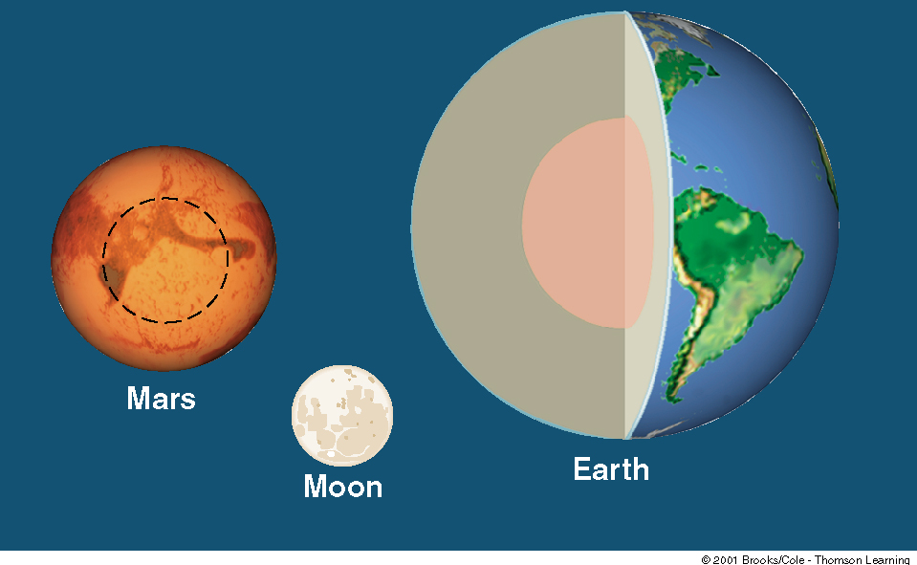
Earth Mars Moon
Gravity (m/s² ):
Press_{atm} (mbar):
Atm. Gases:
Temp (mean) (C):
Solar day (hr.):
Year (days):
9.81
1,000
N₂ 78%
O₂ 21%
Ar <1%
14
24
365.26
3.73 (0.38 ☑)
6 (0.006 ☑)
CO₂ 95%
N₂ 3%
Ar 1.6%
-55
24:38 (1.026 ☑)
687 (1.88 ☑)
669.6 Mars days
1.64 (0.167 ☑)
0 (0 ☑)
-20 (-170 - +130)
708:43 (29.53 ☑)
365.26 (1 ☑)
12.4 Moon days

Slide 16
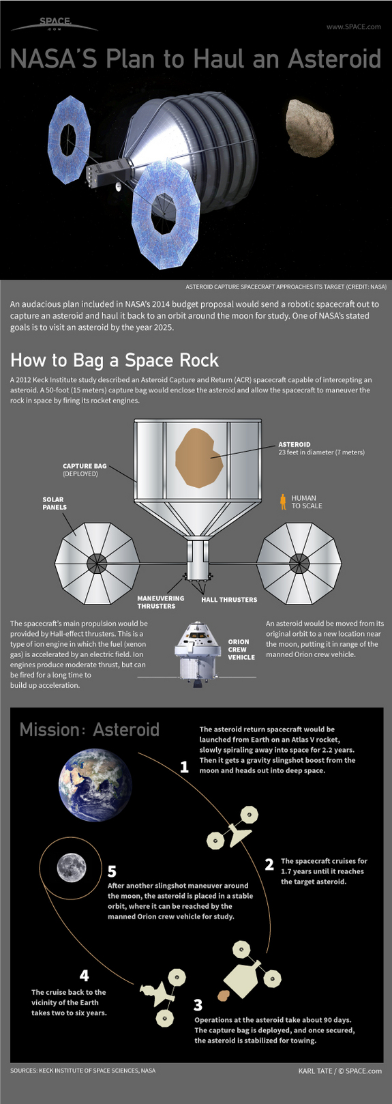
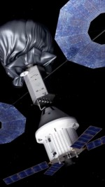
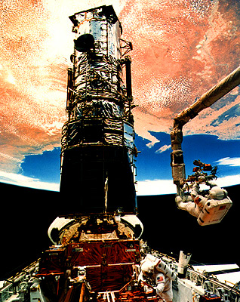
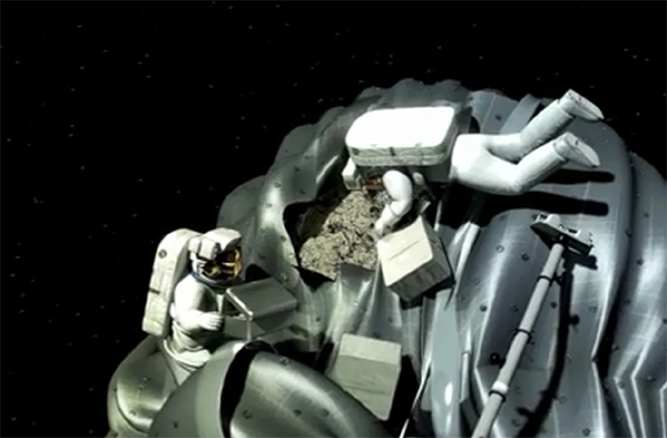
The Moon

Slide 17
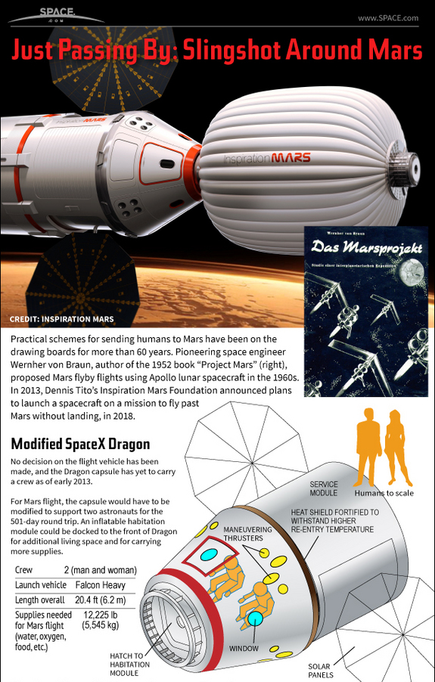
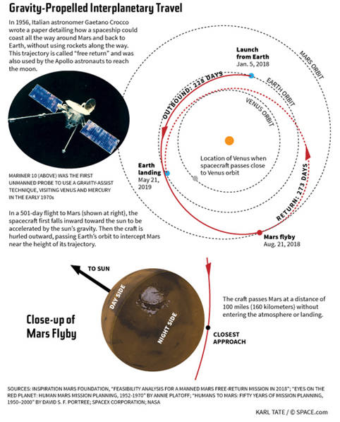
Mars

Slide 18
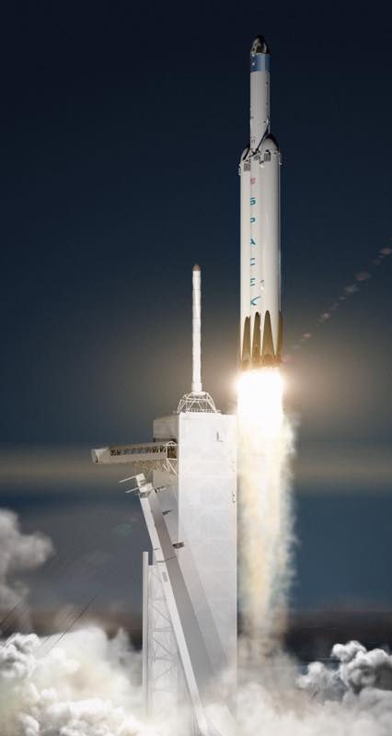
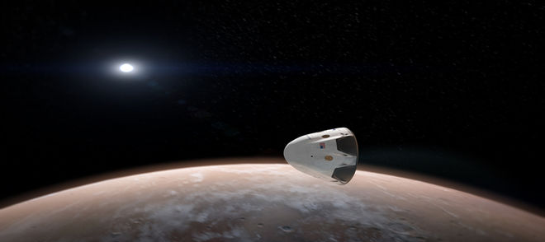
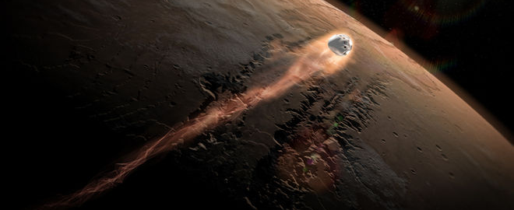
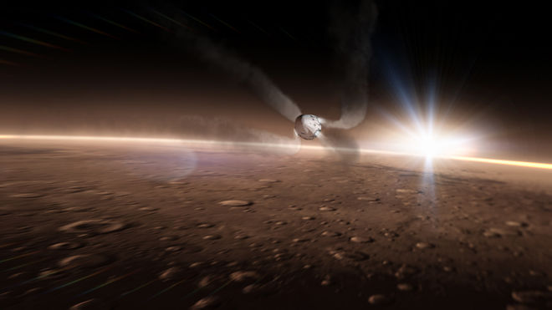
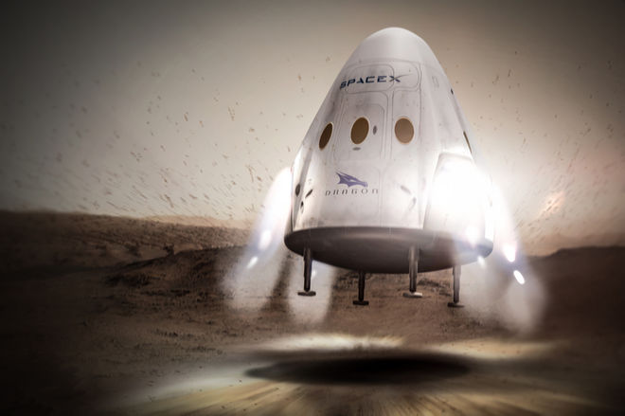
2018, 2020, 2022…

Slide 19
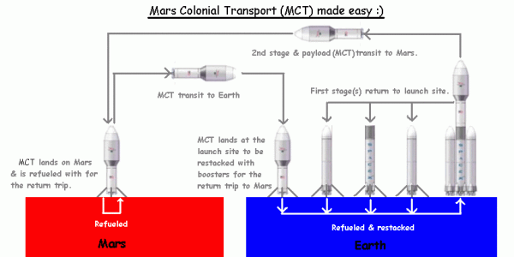
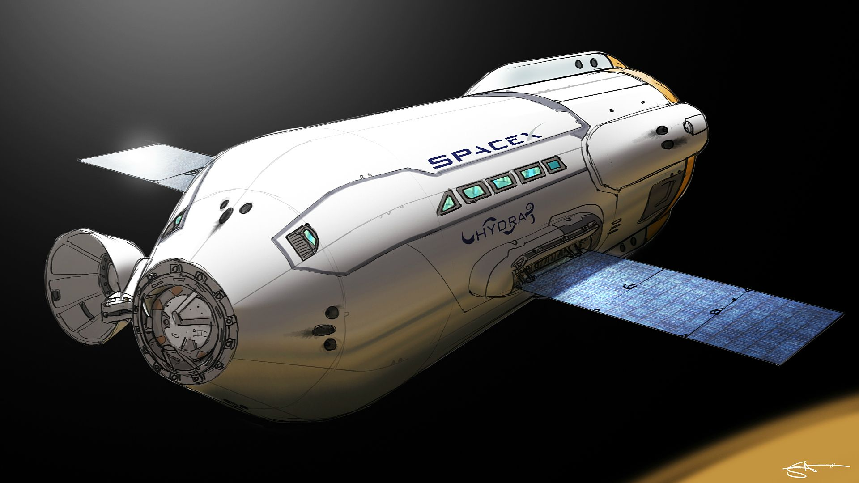
…2025…

Slide 20
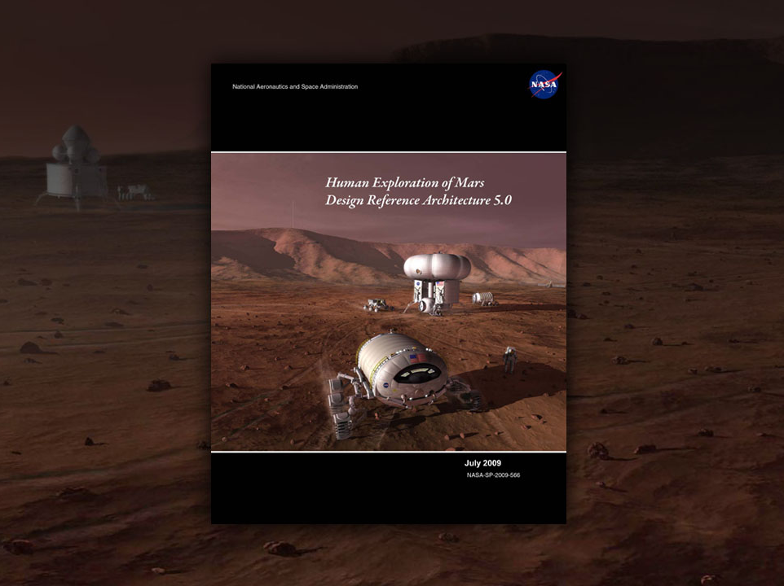

Slide 25
Typical Mars Mission Durations (2030-2047)
Worst-case Opposition-class Mission (2030)
369
399
671
192
222
548
Individual Exposures
Best-case Opposition-class Mission (2039)
200
700
Baselined Conjunction-class Mission
0
450
900
Flight Duration (days)
Notes:
24

Slide 26
Continuous space flight exposure ≥ 30 days
But what
about this…?
Most long-duration flights have been 4-7 months long
Individual Exposures
Mars missions may last up to 30 months
0
450
900
Flight Duration (days)
Notes:
25

Slide 27
Time Course of Physiological
Changes in Weightlessness (notional)
Skylab
ISS
NOTIONAL
Shuttle

Slide 28
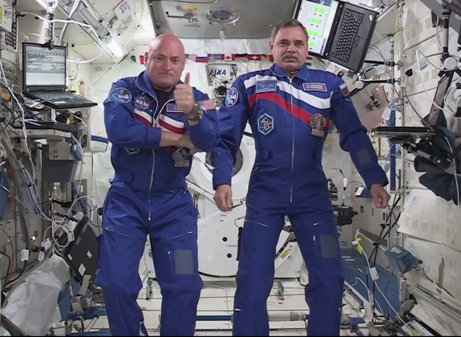

Slide 29
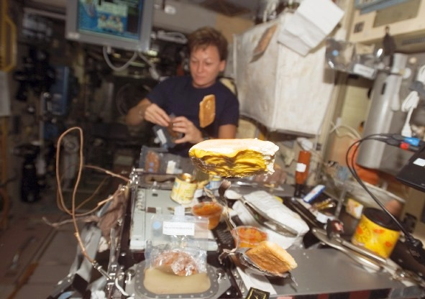
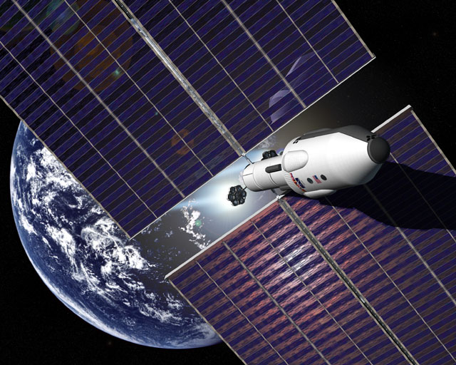
Mars Transit
Facilities must be mostly autonomous (one-way Earth-Mars communications time is 3-22 min.)
Nutrition
Exercise
Psychological support
planned activities
entry/landing simulations
housekeeping
refresher training
cruise science (rover operations/site preparation, microgravity, astronomy, and biomedicine)
communications
reliable contact with mission control, family, & friends
Health Care
autonomous care
telemedicine

Slide 30
Variation in Distance and Communications Delay Between Earth and Mars (example: 2001-2005)
Farthest from Earth
Distance (AU)
Outbound transit to be simulated on ISS
Comm. delay (min.)
Depart Mars
Arrive at Mars
Closest to Earth
Depart Earth
Arrive at Earth
Calendar date

Slide 31
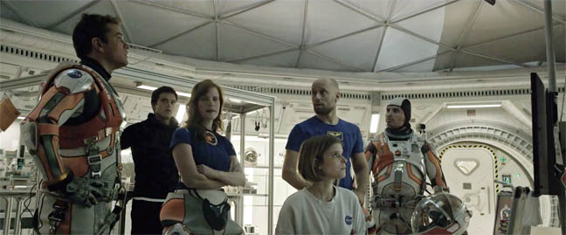
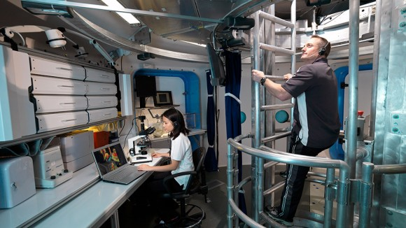

Slide 32
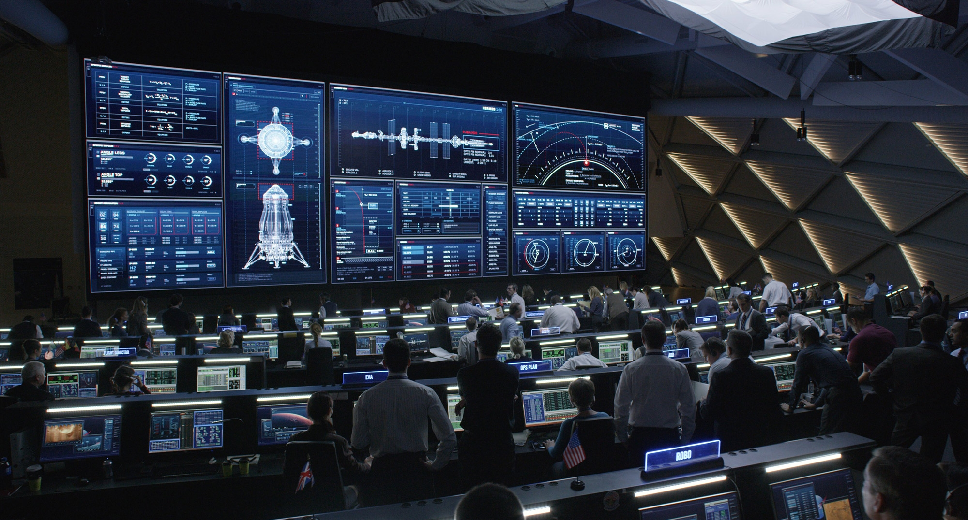

Slide 33
Initial Identification of the VIIP: Subjective Changes in Vision
50% of long- duration (ISS) mission astronauts report a subjective degradation in vision, primarily increasing farsightedness
Hyperopic shift
Decreased near visual acuity, distant vision intact
Normal Eye
(1 mm decrease in axial length is equivalent to a 3 diopter hyperopic shift)
Hyperopic Eye
Notes:
Farsightedness, or hyperopia, is the opposite of nearsightedness. The hyperopic eye focuses images slightly behind the retina, making nearby objects appear blurry.

Slide 34
In Flight B-scan Ultrasound
Notes:
B-scan image The echoes returned to the probe are displayed as a series of dots that form an image, the brightness of which is determined by the strength of the echo, allowing the examiner to determine the density of the tissue for diagnostic purposes.
33

Slide 35
ISS In-flight Crew Ultrasound Imaging: Additional Signs of Raised Intracranial Pressure
1. Increased Optic Nerve Sheath Diameter
Terrestrial Normal < 5.9mm
3. Raised Optic Disc
2. Posterior Globe Flattening
Flattening of Posterior Globe

Slide 36
Fluid Shifts Investigation
M. Stenger (NASA), A. Hargens (UCSD), S. Dulchavsky (HFH), I. Alferova (RAS IBMP)

Slide 37
Musculoskeletal Loss & Treatment
Bone
Resistive Exercise
Nutrition
Decrease the salt!
Bisphosphonates
1 G
0 G

Slide 38
Bone Integrity in Weightlessness
5
Space flight
2 years post-menopause, n=13
n=22
(for comparison only)
0
-5
-10
Change from pre-flight (%)
-15
-20
?
-25
Time
6
12
18
24
30
36
(months)
2018
l
On Mars
l
In-bound
Mission
Outbound
2022
Outbound
l
On Mars
l
In-bound
Opportunities

Slide 39
Exercise on ISS
Aerobic Exercise
Resistive Exercise
Notes:
Slide added 6/99 from Dr. Williams

Slide 42
Artificial Gravity Option
1999: Bimodal NTR
2002: NEP
~4 rpm
~125 m
1969: NERVA
1.0-g

Slide 43
Artificial Gravity
(Short-Radius Centrifuge)
Aerobic Exercise
Resistive Exercise
For a Mars Mission – based on today’s best practices –
1. Exercise on ISS is mostly effective (not perfect) on maintaining functionality for a gravity environment. Crew individual sensitivities need to be better understood.
2. Exercise will be essential for a long duration micro-gravity mission
3. Reduced mass hardware is needed
4. If bone/muscle/aerobic capacity is not maintained the crew will have limited functionality on a planetary/gravity environment and will affect long term health
Notes:
Slide added 6/99 from Dr. Williams

Slide 44
Environmental Hazards
Dust
Mechanical impacts
Medical risk if inhaled
Biohazards
Possible threat to crew (maybe not)
Planetary protection issues (Mars as well as Earth)

Slide 46
Surface Architecture and Activities
approx 500 m
Ascent vehicle
Habitat

Slide 47
Crew Performance for Mars Landing
162 days
125 days
1 year

Slide 48
Field Test Investigation
M. Reschke (NASA), I. Kozlovskaya (RAS IBMP)
Notes:
Field Test.
Twins Study.
Inflight post-vax blood draw 5 October.
Ground: Saturday 2 October. Blood/urine/buccal/saliva/fecal; CardiOx/Ultrasound; Telomeres; Cognition; Fluid Shifts-Chibis; flu vax, TIME coverage. Post-vax blood draw ~1 week later.

Slide 49
Behavioral Health and Performance
Behavioral Medicine Risks
Sleep Risk
Risk of Adverse Behavioral Conditions
Risk of Performance Errors due to Fatigue resulting from Sleep Loss, Circadian De-synchronization, Extended Wakefulness and Work Overload
Team Risk
Risk of Psychiatric Disorders
Risk of Performance Decrements due to Inadequate Cooperation, Coordination, Communication & Psychosocial Adaptation within a Team

Slide 54
Earth Return Transit Requirements
Crew health care
Nutrition
Psychological support
meaningful work
simulations of Earth landing, (normal and emergency)
debriefs, reporting, & consultation with investigators
housekeeping
cruise science
communications
Habitat
Maintenance & housekeeping
Exercise
Recreation
Privacy

Slide 55
Notes:
OK, if an omics study of one person can be worthwhile,
So can a study of the Kelly twins

Slide 56
Vasculature
Lee
Cognition
Basner
Microbiome
Turek
Targeted and Global Metabolomics
Lee/Rana, Mignot/Snyder & Smith
Cytokines
Mignot
Telomere Length
Bailey
B-cells / T-cells
Mignot
Antibodies
Mignot/Snyder
Scott Kelly – ISS for one year
Chromatin
Feinberg
Mark Kelly – Earth control
DNA Mutations
Feinberg
DNA Hydroxy-methylation
Mason
large/small RNA
& RNA Methylation
Mason
DNA Methylation
Feinberg & Mason
Proteomics
Lee/Rana

Slide 58
SpaceX-8
Recovery
May 11, 2016
SAMPLE TYPE |  | ALL | 1YM, Twins
Blood |  | 205 | 103 (450 ml)
Urine |  | 508 | 186 (1.3 L)
Saliva |  |  | 170
 | Bags | 172
 | Vials | 66
Surface swabs |  | 119
Galley water |  | 6
Fecal samples |  | 8

Slide 59
Exploration Brings Risks…

Slide 63
Risks of Human Spaceflight

Slide 64
Human research in space flight?
Yes!

Slide 65
www.nasa.gov/hrp
john.b.charles@nasa.gov

